Slide 1
NRO NC Update
(ASO AC)
Address Policy Working Group | RIPE 90 | 14 May 2025
Notes:
‹#›
‹#›
‹#›

Slide 2
About the NRO NC
(Serves as the ASO AC)
‹#›
‹#›
Notes:
‹#›
‹#›

Slide 3
ICANN ASO AC (Address Council)
What is it? | The Address Supporting Organization (ASO) was established by ICANN to advise on Internet number resource policy
How is it organized? | 15 members (3 from each RIR region) In each region - two are elected, one is appointed by the RIR
How long do members serve? | Varies by region
What does it do? | Advises the ICANN Board Oversees the Global Policy Development Process Appoints two members to the ICANN Board (seats 9 & 10) Appoints one member to the ICANN Nominating Committee
When does it meet? | Monthly virtual meetings Annual in-person meeting
‹#›

Slide 4
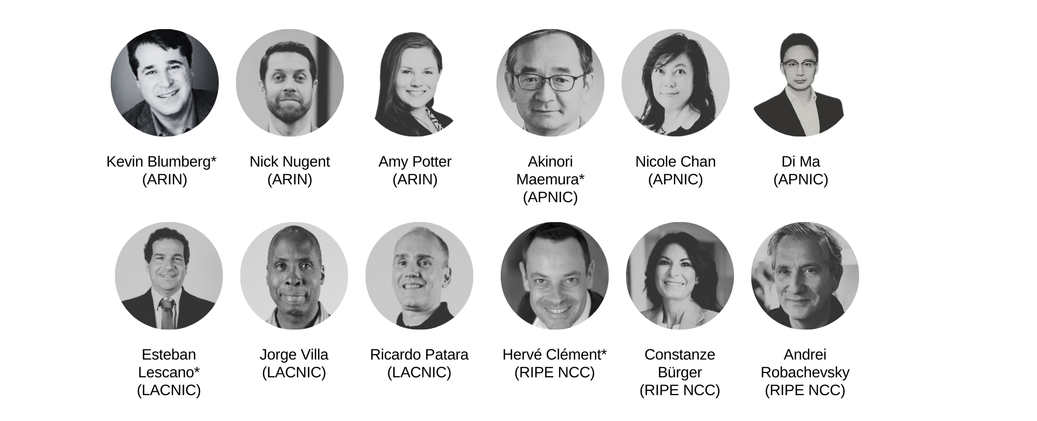
2025 Members
*Appointed by RIR Board
‹#›

Slide 5
2025 Focus of Work
Conduct Election for Seat 10 of the ICANN Board
Monitor and support Global Policy Development Process
Conduct ICP-2 Review Process

Slide 6
Seat 10 Election
Christian Kaufmann has been selected to serve on Seat 10 of the ICANN Board
He will serve a three-year term starting in October 2025 at the conclusion of ICANN 84
Details of the selection process are available at:
https://aso.icann.org/icann-board/icann-board-elections/2025-icann-board-of-directors-seat-10-election/

Slide 7
NRO NC Transparency
Annual Face to Face – OPEN to Observers
  Next meeting scheduled for ICANN 83 in Prague | 9-12 June 2025
Mailing Lists OPEN with archives
https://aso.icann.org/contact/
ASO AC Monthly Teleconference OPEN to observers.
  Usually, the first Wednesday of each month at 12:00 PM UTC
  Meeting Calendar: https://aso.icann.org/aso-ac/meetings/aso-ac-meeting-schedule/

Slide 8
ICP-2 Review
Background Information, Process and Timeline
‹#›
‹#›
Notes:
‹#›
‹#›

Slide 9
What is ICP-2?
Internet Coordination Policy 2
Document that provides criteria for recognizing new RIRs
  Examples
    Sufficiently large proposed service region
    Support of local numbering community
    Technical capability
https://www.icann.org/resources/pages/new-rirs-criteria-2012-02-25-en
‹#›

Slide 10
ICP-2 Timeline
(New RIRs under ICP-2)
1992 |  | RIPE NCC established
1993 |  | APNIC established
1997 |  | ARIN established
1998 |  | ICANN established
2001 |  | ICANN adopted ICP-2
2002 |  | LACNIC established
2005 |  | AfriNIC established
‹#›

Slide 11
Why revisit ICP-2?
ICP-2 is nearly 25 years old
  The Internet has changed over the last quarter century
  The relationships between RIRs and ICANN and between each other have changed
Need to more explicitly provide for
  An RIR’s ongoing responsibilities
  Potential de-recognition of an RIR that can no longer adequately provide for the needs of its numbering community
‹#›
‹#›
Notes:
‹#›
‹#›

Slide 12
ICP-2 Review Project
On 25 October 2023, the NRO EC* asked the ASO AC to help with two tasks aimed at strengthening the RIR system:
    ICP-2 Implementation Procedures: Review and advise the NRO EC on its draft procedures for validating and addressing ongoing RIR compliance with ICP-2 (“Implementation Procedures”)
    Strengthen ICP-2: Revise ICP-2 to make the RIR system more accountable to the Internet community
*Read more about the NRO EC at: https://www.nro.net/about/executive-council/
‹#›

Slide 13
ICP-2 Review Timeline
(Principles Document and Consultation)
8 Oct 2024 |  | ASO AC published a proposed set of 24 “core principles” to be included in the next version of ICP-2 (“Principles Document”)
8 Oct – 6 Dec 2024 |  | Public consultation on the ICP-2 Principles Doc
Dec 2024 – Feb 2025 |  | ASO AC reviewed community feedback on ICP-2 Principles Document received during public consultation
24 Feb 2025 |  | ASO AC published ICP-2 Questionnaire Summary Report (“ICP-2 Principles Consultation Report”)
14 April 2025 |  | ASO AC published draft “RIR Governance Document” and launched community consultations
‹#›

Slide 14
ICP-2 Review Timeline (continued)
The Draft “RIR Governance Document” Consultation
14 April 2025 |  | Draft “RIR RIR Governance Document” published RIR consultations in each region and ICANN Public Comment proceeding launched
27 May 2025 |  | Public consultation closes
9-12 June 2025 |  | ASO AC will review feedback received
September 2025 |  | The revised “RIR Governance” document will be published
Q4 2025 |  | Final review and revision of updated document Begin NRO and ICANN approval and adoption process
‹#›

Slide 15
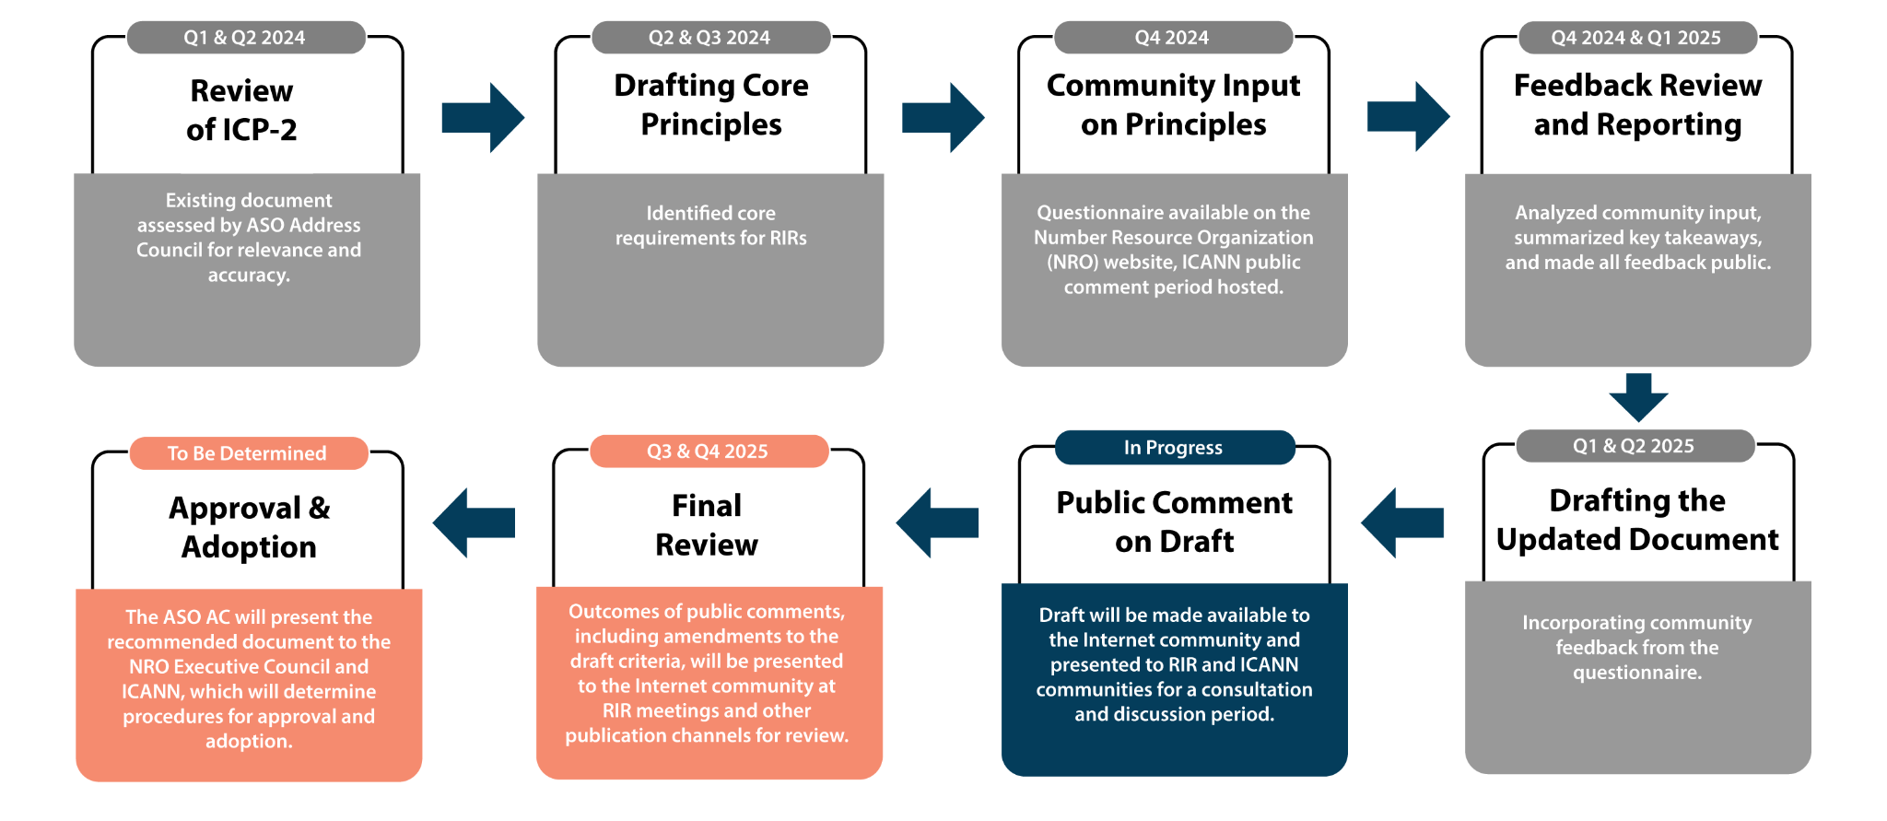


ICP-2 Review Timeline
‹#›

Slide 16
Proposed Principles to Update ICP-2
(completed)
‹#›
‹#›
Notes:
‹#›
‹#›

Slide 17
Core Principles and Consultation
The ASO AC drafted proposed principles that would form the basis of updating ICP-2. The principles were shared with the RIR and ICANN communities for feedback from 8 October to 6 December 2024.
ICANN Public Comment: 14 responses received
RIR Questionnaire: 298 responses received
The responses were analysed, and a summary report of the RIR Questionnaire was published in February 2025. Input from both processes was used to inform the drafting of the document.
‹#›

Slide 18

ICP-2 Principles Consultation Report
https://www.nro.net/policy/internet-coordination-policy-2/icp-2-principles-questionnaire-report-and-data/
‹#›
‹#›
Notes:
‹#›
‹#›

Slide 19
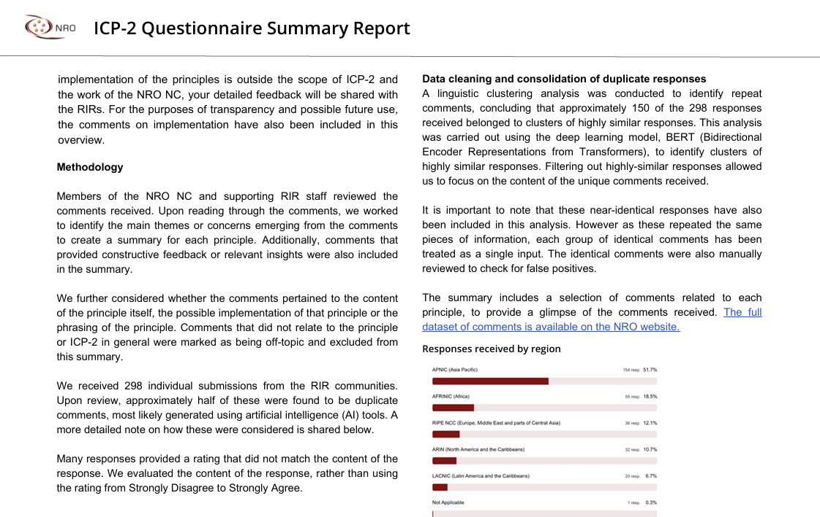
‹#›

Slide 20
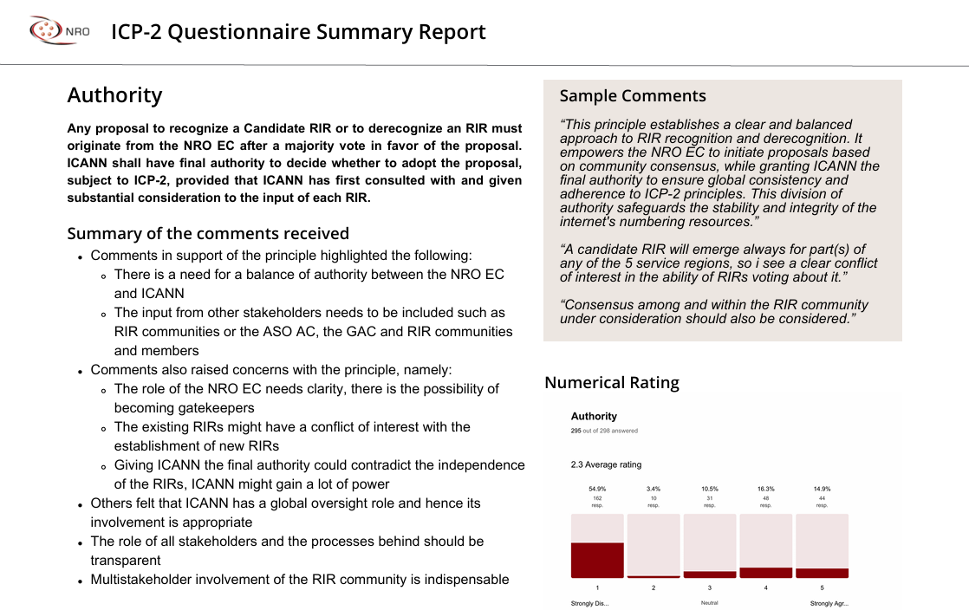
‹#›

Slide 21
Incorporating Community Feedback
All the comments received were reviewed and categorised:
  Did they pertain to the principle itself, the phrasing of the principle or the future implementation of the principle?
  The comments were clustered around the main issues they addressed e.g. the role that ICANN plays, concerns about due process, need to rehabilitate an RIR prior to a possible derecognition
These concerns were summarised and added to a working sheet:
  The NRO NC discussed the concerns raised
  Depending on the feedback, we decided whether it was within scope and if we wanted to address it in the draft “RIR Governance Document”

Slide 22
How We Used Community Feedback in the Draft
Clarified the role of the community - an RIR decision implies a corresponding process that is necessary according to the RIR governance model
Addressed procedural concerns about the recognition and derecognition procedures- added a provision for appeal and ICANN’s review process respectively.
Aligned the requirements with common privacy and corporate governance requirements
Elaborated where necessary to address questions about the principles
Input focused on implementation of the principles will be considered when developing implementation procedures.

Slide 23
Introducing the Draft “RIR Governance Document”
Governance Document for the Recognition, Maintenance, and Derecognition of Regional Internet Registries

Slide 24

Draft “RIR Governance Document”
https://www.nro.net/policy/internet-coordination-policy-2/rir-governance-document/
‹#›
‹#›
Notes:
‹#›
‹#›

Slide 25
The draft “RIR Governance Document” represents a comprehensive update to ICP-2, introducing detailed governance structures, operational requirements, and procedures for the full lifecycle management of RIRs, all developed through extensive community consultation. The draft document:
Clarifies scope and lifecycle management
Formalises governance structures
Strengthens operational requirements
Clarifies roles, responsibilities, and procedures

Slide 26
Clarified Scope and Lifecycle Management
Original ICP-2 (2001): Focused primarily on the criteria for the establishment of new RIRs.
RIR Governance Document (2025): Clarifies the scope to encompass the entire lifecycle of RIRs, including:
• Recognition: Criteria and processes for recognizing new RIRs.
• Operation: Ongoing obligations and requirements for RIRs to maintain recognition.
• Derecognition: Establishes procedures for the potential derecognition of RIRs that fail to meet specified criteria.

Slide 27
Formalization of Governance Structures
Original ICP-2: Outlined principles such as neutrality, impartiality, and bottom-up policy development but lacked detailed governance structures.
RIR Governance Document: Introduces more detailed governance requirements, including:
• Member-Controlled Governance: Majority of an RIR’s governing body must be elected by its members.
• Corporate Governance: Requires RIRs to adhere to good corporate governance procedures.
• Anti-Capture Measures: Requires RIRs to implement controls to prevent any single entity or group from gaining undue influence over an RIR.

Slide 28
Strengthened Operational Requirements
Original ICP-2: Emphasized technical capabilities and the provision of registration services.
RIR Governance Document: Expands operational expectations to include:
• Audit Obligations: RIRs must undergo regular audits by external and independent auditors to ensure compliance.
• Transparency: Requires comprehensive public documentation of governance, activities, and finances.
• Continuity Planning: Mandates procedures and redundancies to ensure service continuity, including the ability for another RIR to assume services if necessary.

Slide 29
Clarification of Roles, Responsibilities, and Procedures
Original ICP-2: Provided general guidelines while only implying the roles of various organisations.
RIR Governance Document: Clearly delineates responsibilities:
• RIRs: Must initially approve any proposal to recognise or derecognise an RIR.
• ICANN: Exercises final authority to approve or reject proposals, following consultation with RIRs.
• Procedures: Specifies procedures and approval thresholds for proposals.

Slide 30
Consultation and Participation Options
14 April 2025 - 27 May 2025

Slide 31
Guidance for Feedback
Please share feedback that is specific to this draft
We are particularly interested in hearing your views on the new requirements in the draft
Whether the draft provides sufficient clarity regarding the ongoing obligations of an RIR and the remediation steps if the obligations are not met
This document does not address the implementation of the RIR criteria; comments on implementation will be considered out of scope
Constructive comments are highly appreciated
‹#›
‹#›
Notes:
‹#›
‹#›

Slide 32
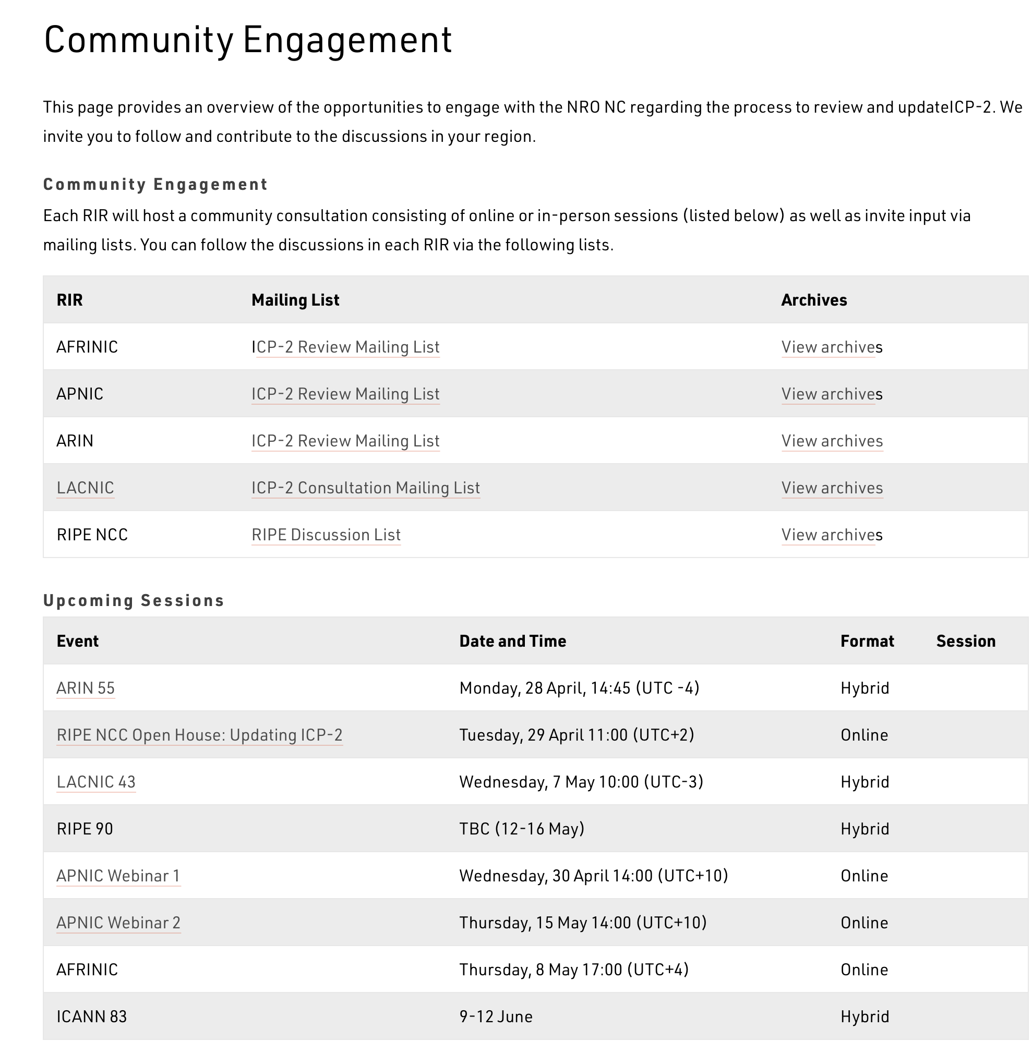

Follow Discussions
The Community Engagement web page on www.nro.net provides an overview of the engagements on ICP-2 with the NRO NC.
This webpage is updated regularly as more sessions get planned. Session archives are also linked here!
https://www.nro.net/policy/internet-coordination-policy-2/community-engagement/
‹#›
‹#›
Notes:
‹#›
‹#›

Slide 33



How to Participate
RIPE Community
Mailing List Discussions
https://mailman.ripe.net/mailman3/lists/ripe-list.ripe.net/
RIPE Community Plenary
Thursday, 15 May
16:00 (UTC+1)
Mailing List Archives
https://mailman.ripe.net/archives/list/ripe-list@ripe.net/
‹#›
‹#›
Notes:
‹#›
‹#›

Slide 34
ICANN Public Comment Open Until 27 May 2025
The proposed “Governance Document for the Recognition, Maintenance, and Derecognition of Regional Internet Registries (RIRs)” (“the RIR Governance Document”) sets forth the
Rules and criteria for recognizing new RIRs
Operating obligations and requirements of RIRs
Rules and criteria for derecognizing RIRs
If adopted by ICANN and the RIRs, the “RIR Governance Document” would supersede and replace the Internet Coordination Policy 2 (ICP-2).
https://www.icann.org/en/public-comment/proceeding/governance-document-for-the-recognition-maintenance-and-derecognition-of-rirs-14-04-2025/submissions

Slide 35
ICP-2 Review Timeline (reminder)
The Draft “RIR Governance Document” Consultation
14 April 2025 |  | Draft “RIR RIR Governance Document” published RIR consultations in each region and ICANN Public Comment proceeding launched
27 May 2025 |  | Public consultation closes
9-12 June 2025 |  | ASO AC will review feedback received
September 2025 |  | The revised “RIR Governance” document will be published
Q4 2025 |  | Final review and revision of updated document Begin NRO and ICANN approval and adoption process
‹#›

Slide 36
Thank You
‹#›

